Slide 1
Magic Movie Analysis

Slide 2



Slide 3
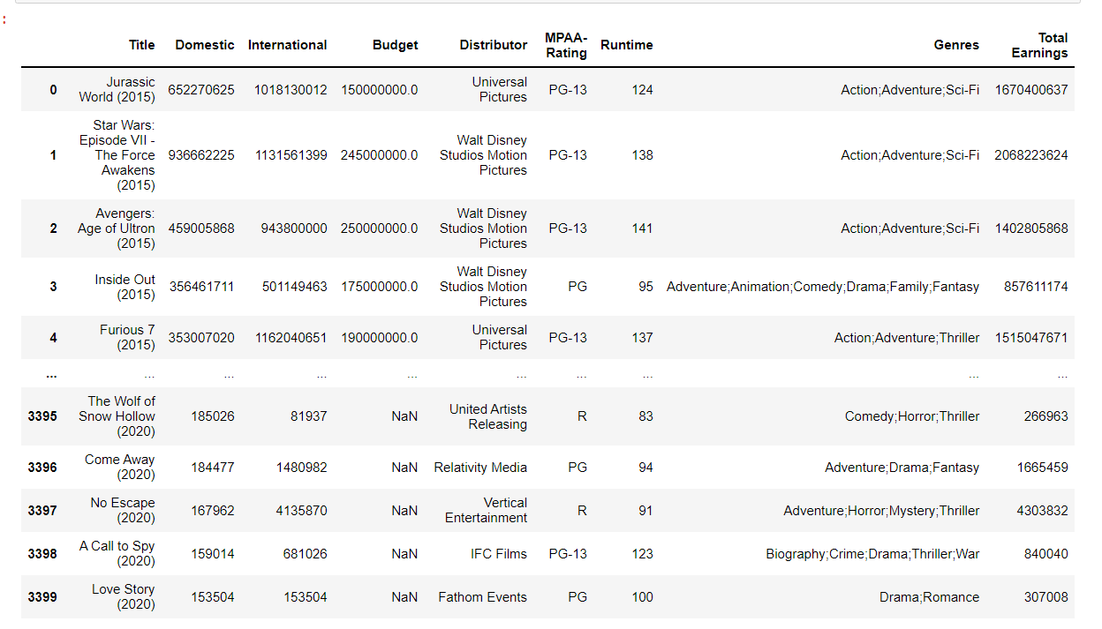
Highest Earning Movies

Slide 4
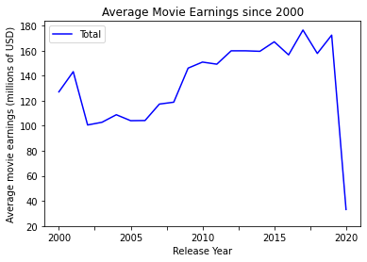
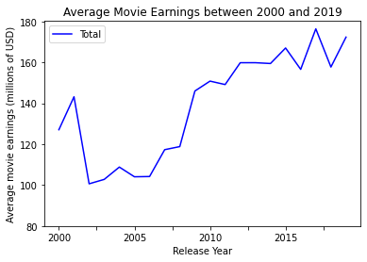
Earnings by year
2020 was a very bad year for movies
Taking out 2020 2002 was also pretty bad but could be skewed by data collection
Only 3400 movies with not entirely random distribution

Slide 5
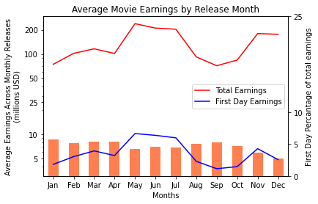
Movie Earnings by Month

Slide 6
Continued Monthly Information
Summer movies have the best earnings
Most releases earn about 4-5 percent of their total cinema earnings on the first day
December movies have bad first day profits but have similar total earnings to summer movies
January releases do the worst overall

Slide 7
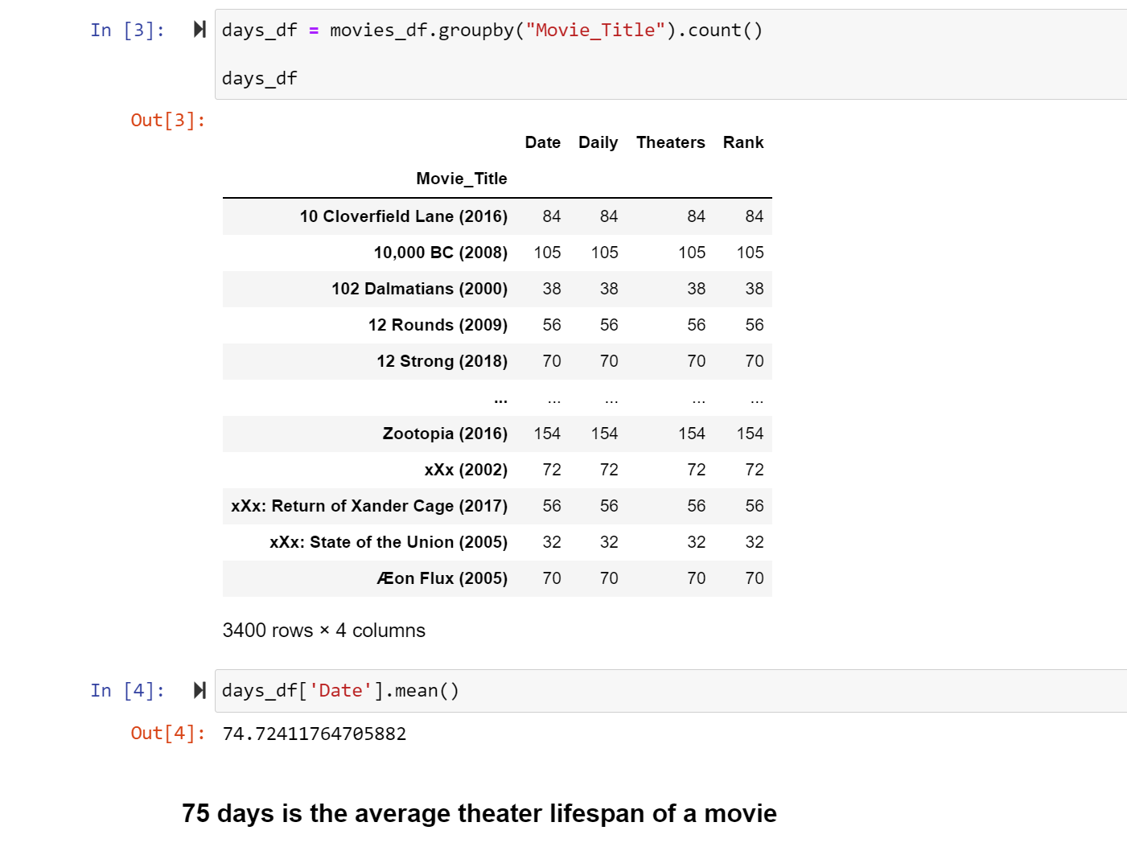
Average Theater Lifespan

Slide 8
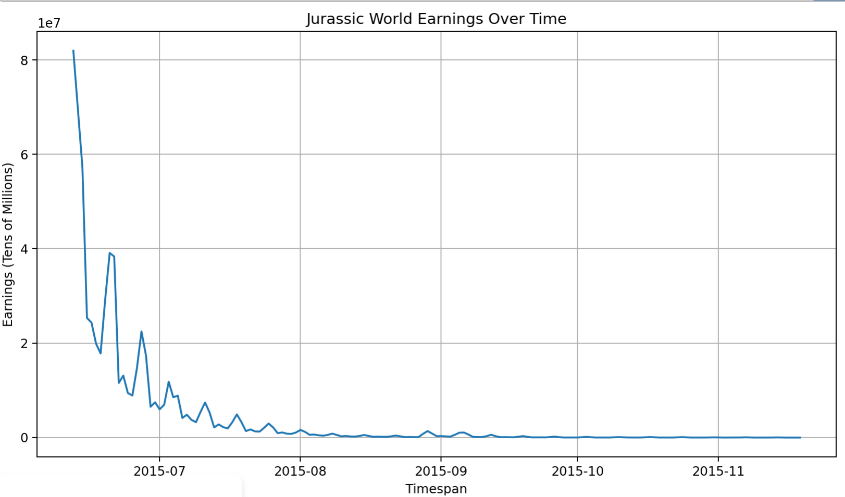
Notes:
Movies experience the height of the earnings at opening then have a study decline with weekend spikes.

Slide 9
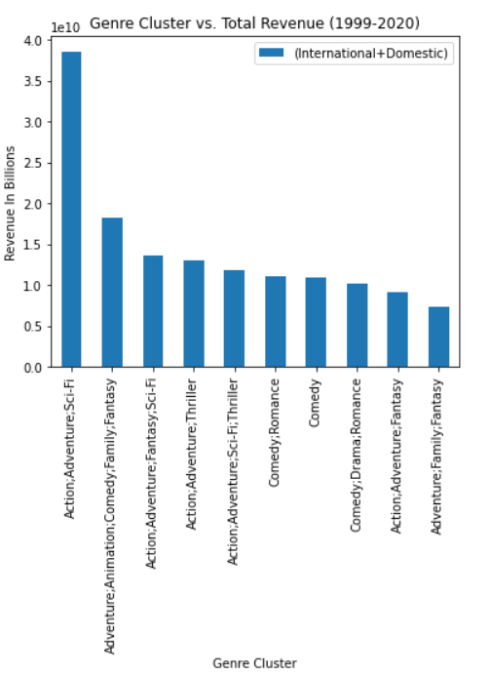
Genre Cluster vs Total Revenue (International & Domestic)
Action / Adventure / Sci Fi were the top earning genre clusters $38 Billion USD
IE. Avengers, Jurassic Park & Star Wars
Adventure / Family / Fantasy was the lower earning genre cluster $7 Billion USD
IE. Dumbo, Inkheart, The Golden Compass

Slide 10
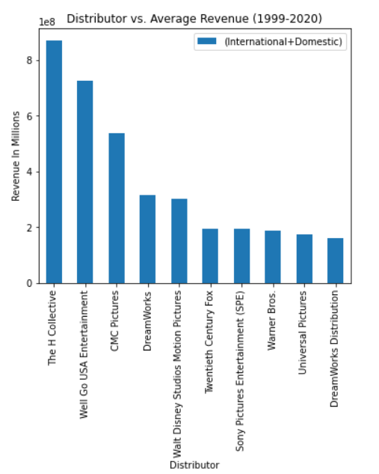
Distributor vs Average Movie Revenue (International & Domestic)
The H Collective leads the charge with an average earnings of $870 Million USD per movie
Paramount Pictures in last with an average of $170 Million USD

Slide 11
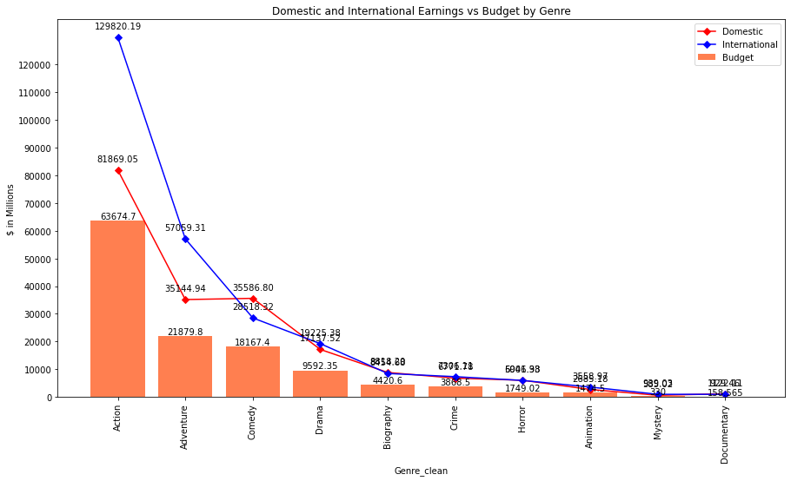
Domestic vs International Earnings by Genre
Summary:
Highest grossing genre is Action at ~$212B earnings (39% domestic vs 61% International)

Slide 12
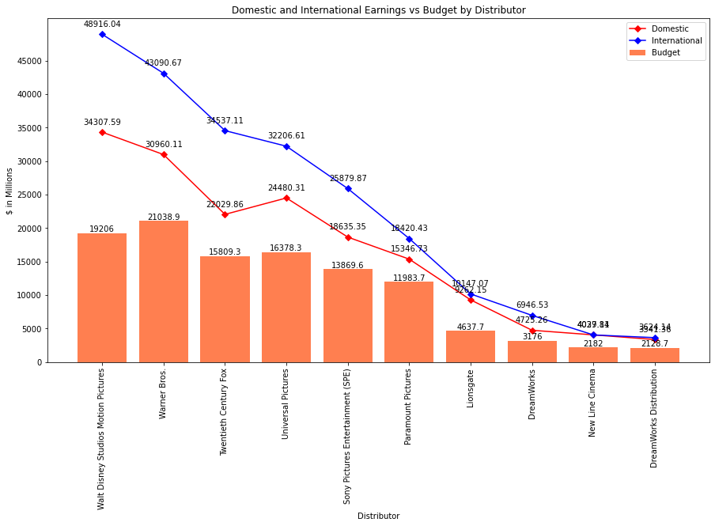
Domestic vs International Earnings by Distributor
Summary:
Highest grossing distributor is Walt Disney Studios Motion Pictures at ~$83.2B earnings (41% domestic vs 59% International)

Slide 13
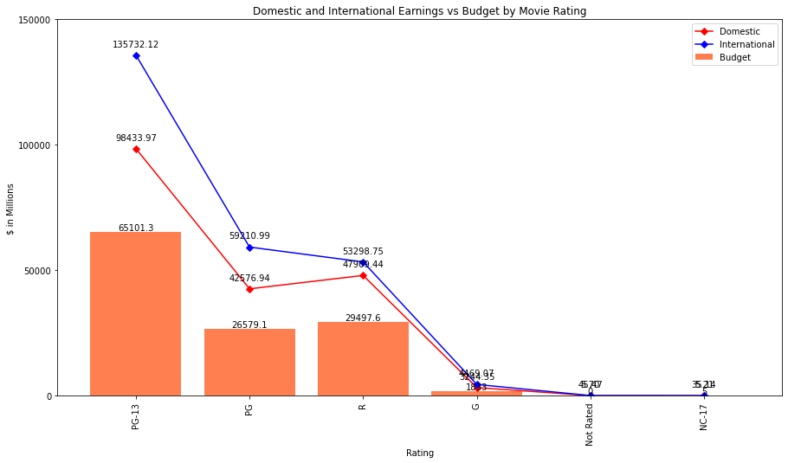
Domestic vs International Earnings by Rating
Summary:
Highest grossing movie rating is PG-13 at ~$234.2B earnings (42% domestic vs 58% International)

